Slide 1




The Smart Normal Constraint Method for
Directly Generating a Smart Pareto Set
Braden J. Hancock
Christopher A. Mattson
Brigham Young University
Dept. of Mechanical Engineering
AIAA-2013-1759
April 8-11, 2013

Slide 2
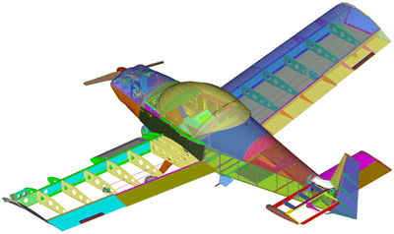
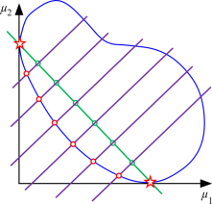
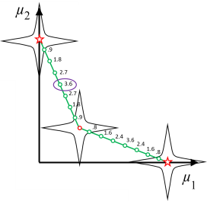
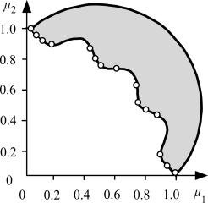
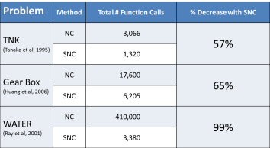
Outline
Motivation
Normal Constraint (NC) Method - Benchmark
Smart Normal Constraint (SNC) Method
Numerical Examples
Conclusions

Slide 3
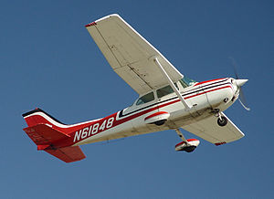
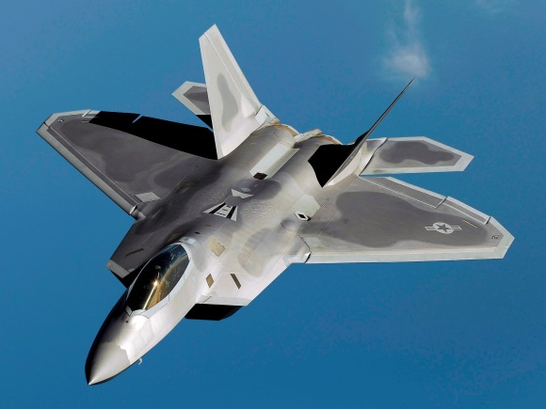
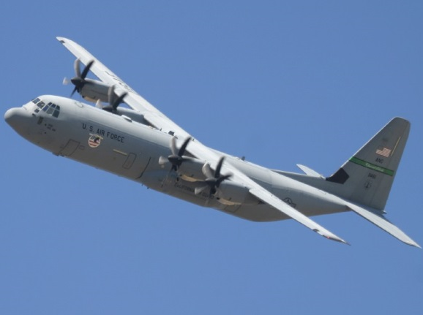
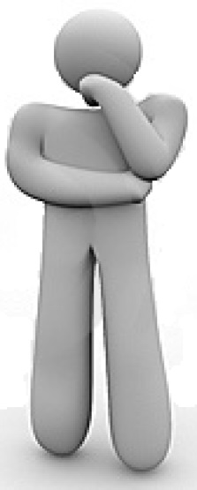
Motivation

Slide 4
Motivation
Radar Footprint
Payload Size
Manufacturability
Fuel Efficiency
Maximum Speed
Backwards Compatibility
Cost
Carbon Emissions

Slide 5

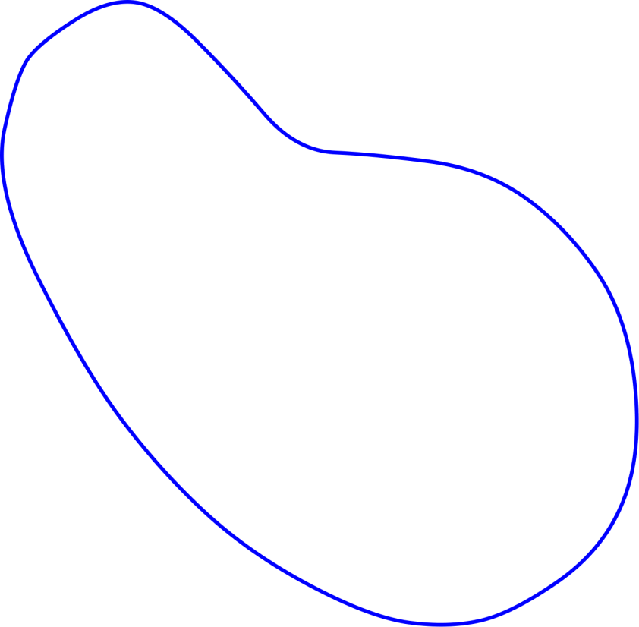
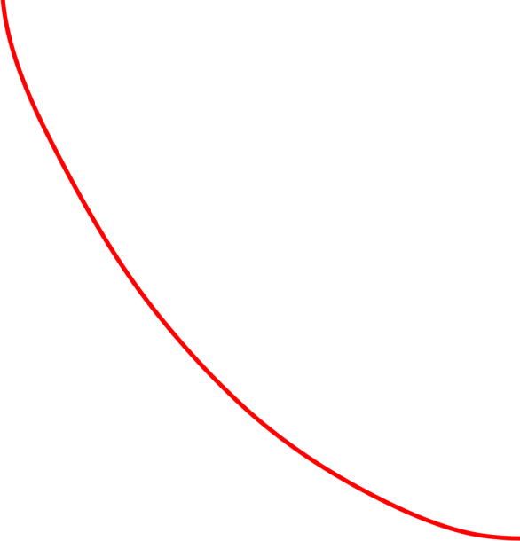

Motivation
Feasible Design Space
Pareto Frontier
Weight
Ideal Location
(infeasible)
Cost

Slide 6
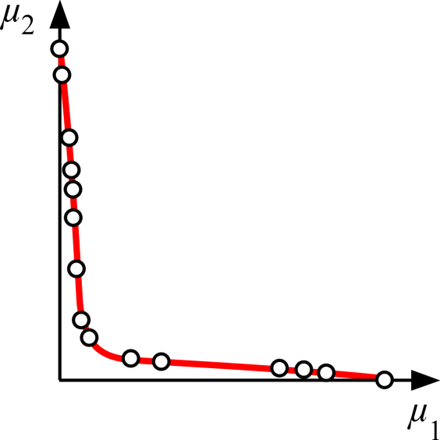
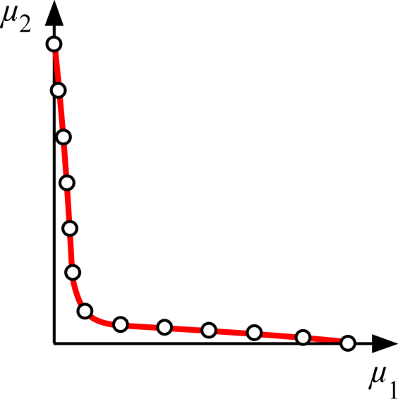
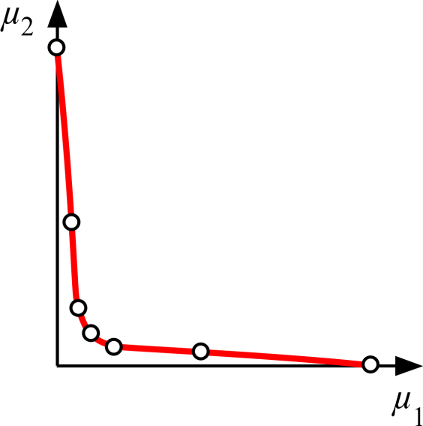
Evolution of Algorithms
Phase 1
Phase 2
Phase 3
(any Pareto set)
(evenly-distributed Pareto set)
(“smart” Pareto set)

Slide 7
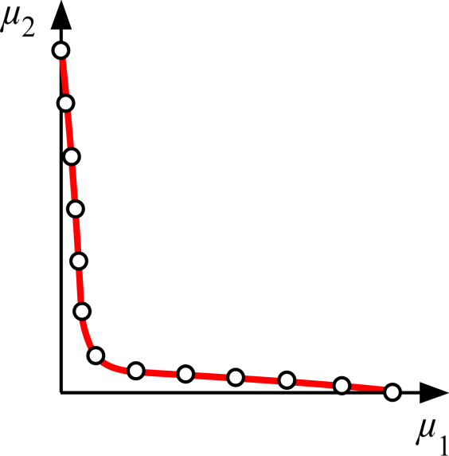
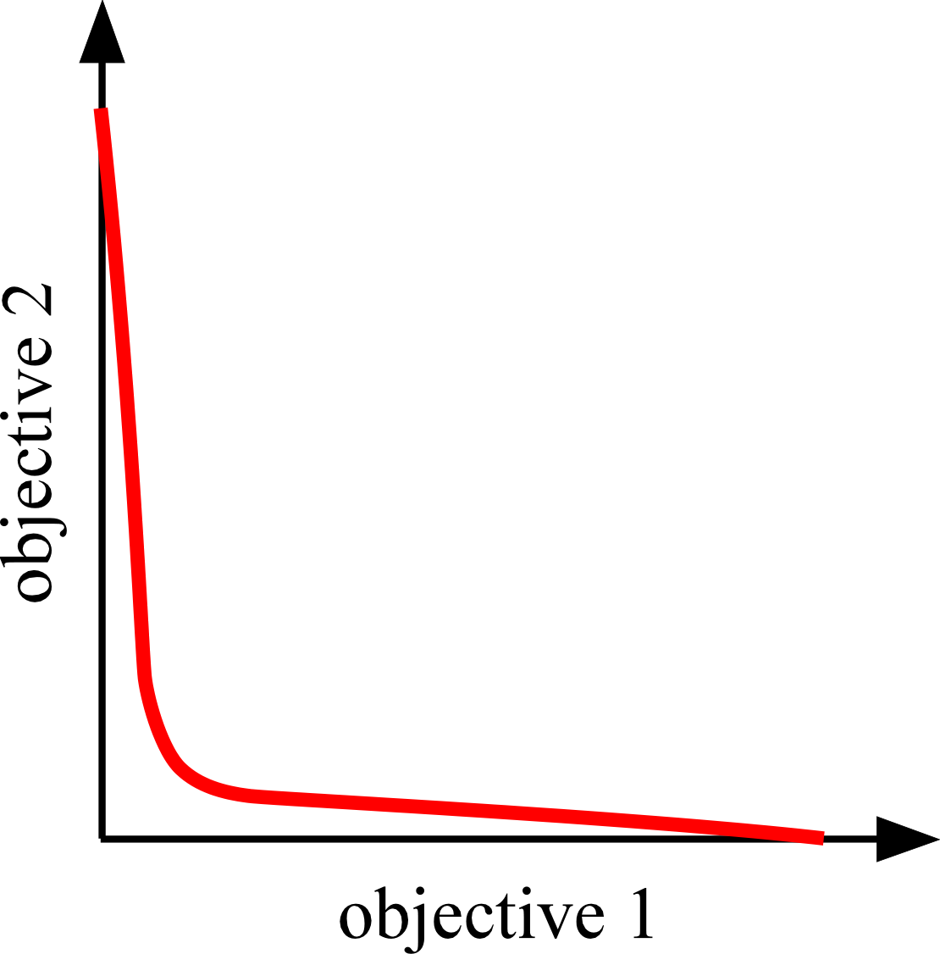
Current Method

Slide 8
Proposed Method

Slide 9
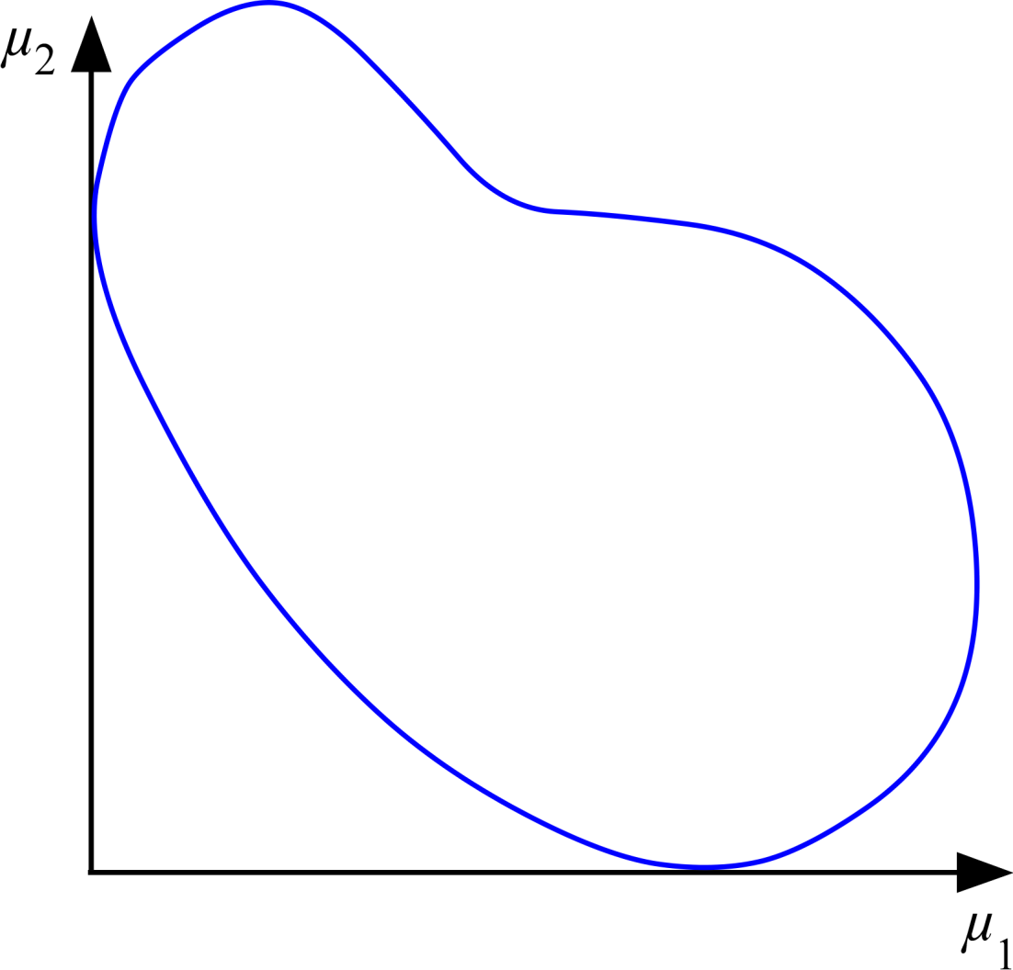
Normal Constraint (NC) Method
SOOs
NC Method Steps:
Reference Points
Utopia Line Vector(s)
3) Utopia Line Points
4) Single-Objective Optimization
(µ₂)
(µ₂)
(µ₂)
(µ₂)
(µ₂)
(µ₂)
(µ₂)
(µ₂)
MOO
(µ₁ , µ₂)
The Normal Constraint (NC) Method was first developed by (Messac et al, 2003)

Slide 10
NC Method: Step 1
NC Method Steps:
Reference Points
Utopia Line Vector(s)
3) Utopia Line Points
4) Single-Objective Optimization
Anchor Point μ^{1*}
Anchor Point μ^{2*}

Slide 11
NC Method: Step 2
NC Method Steps:
Reference Points
Utopia Line Vector(s)
3) Utopia Line Points
4) Single-Objective Optimization
Utopia line vector

Slide 12
NC Method: Step 3
NC Method Steps:
Reference Points
Utopia Line Vector(s)
3) Utopia Line Points
4) Single-Objective Optimization

Slide 13
NC Method: Step 4
(µ₂)
(µ₂)
(µ₂)
(µ₂)
(µ₂)
(µ₂)
NC Method Steps:
Reference Points
Utopia Line Vector(s)
3) Utopia Line Points
4) Single-Objective Optimization
(repeat bracketed step)

Slide 14
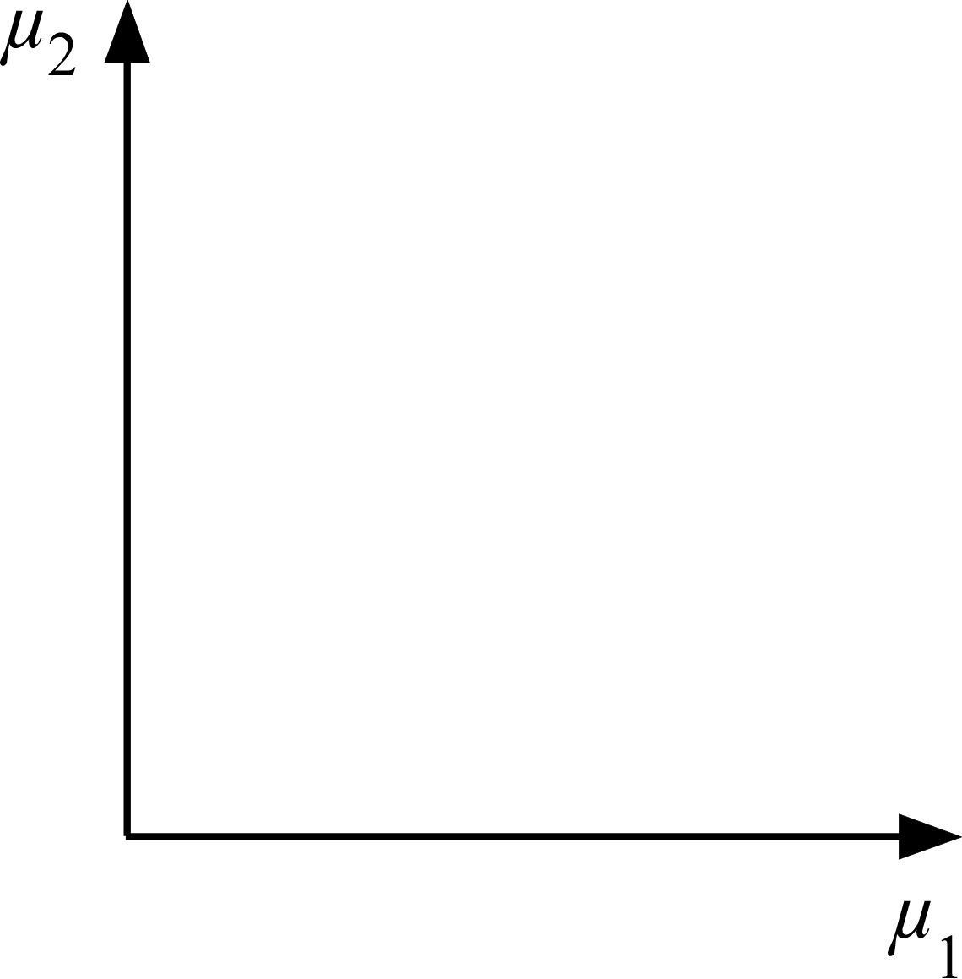
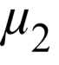
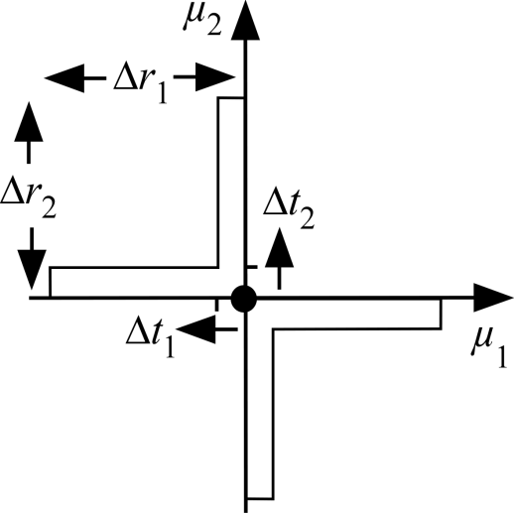

Smart Pareto Filter
Practically Insignificant Tradeoff (PIT) region
The smart Pareto filter was first developed by (Mattson et al, 2004)

Slide 15
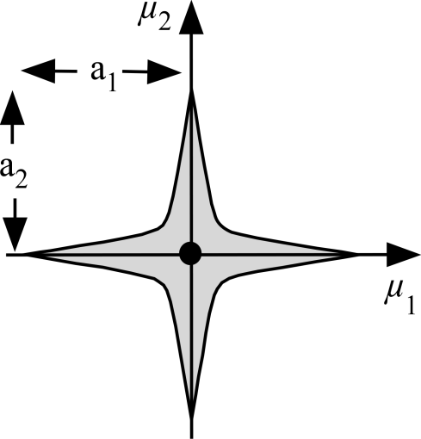
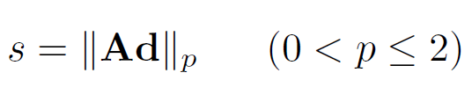
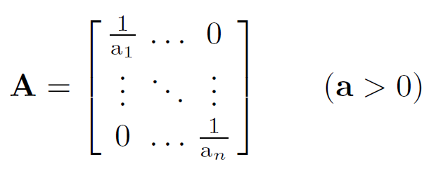


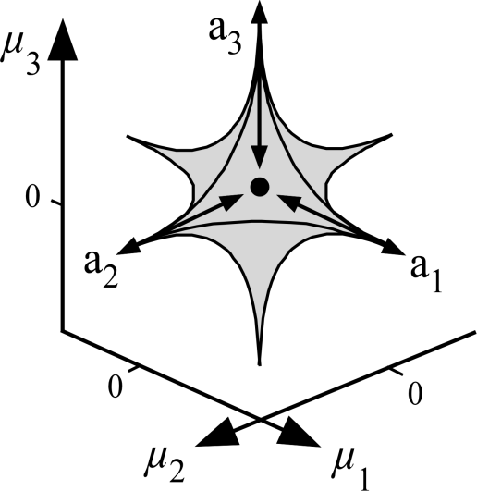
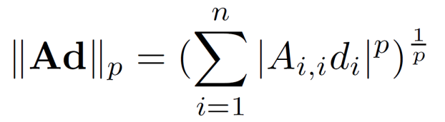
Smart Distance
Practically Insignificant Tradeoff (PIT) region
p
(1)
“ ”
(2)
p
(3)

Slide 16
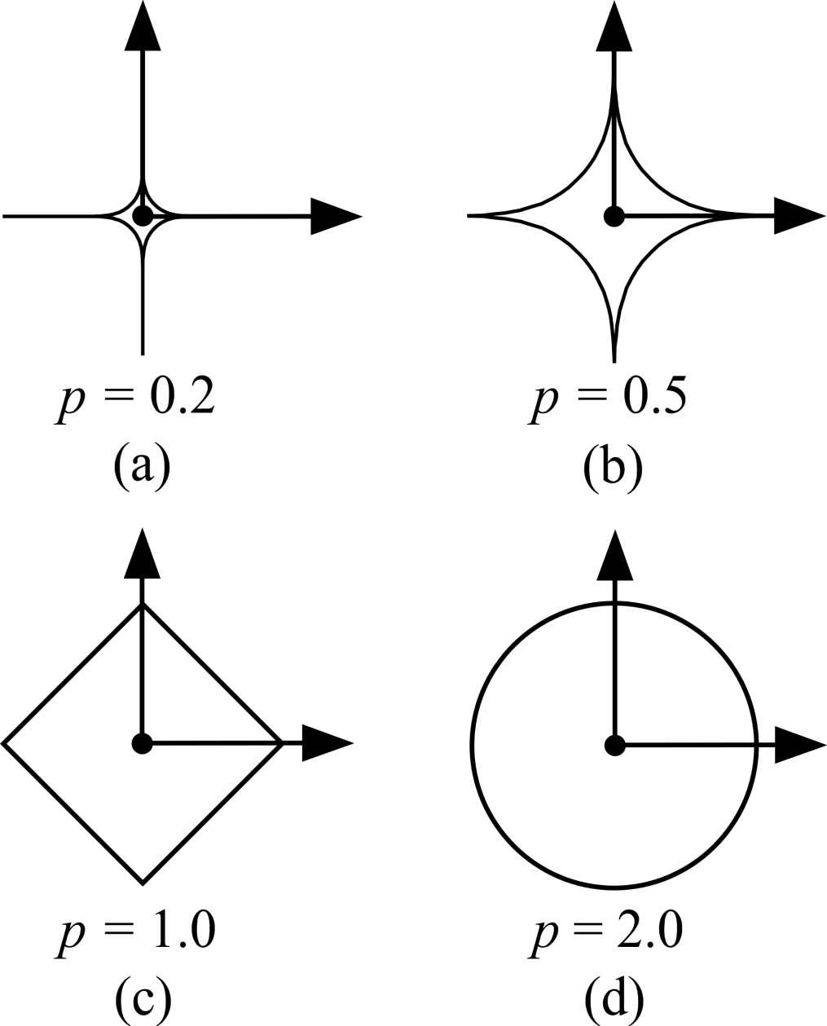
Smart Distance

Slide 17

Smart Distance
s = 1
Inside PIT → s < 1
On PIT → s = 1
Outside PIT → s > 1
s = 1
s = 0.5
s = 2

Slide 18
NC-SNC Methods Comparison
NC Method
SNC Method
Search is based on initial
information
Majority of algorithm steps
Search is based on iteratively updated information

Slide 19
SNC Method: Step 1
SNC Method Steps:
Reference Points
Connectivity of Approximation
Approximation Lines
Approximation Points
5) Calculate Smart Distances
6) Single-Objective Optimization
(repeat bracketed steps)

Slide 20
SNC Method: Step 2
SNC Method Steps:
Reference Points
Connectivity of Approximation
Approximation Lines
Approximation Points
5) Calculate Smart Distances
6) Single-Objective Optimization
(repeat bracketed steps)

Slide 21
SNC Method: Step 3
SNC Method Steps:
Reference Points
Connectivity of Approximation
Approximation Lines
Approximation Points
5) Calculate Smart Distances
6) Single-Objective Optimization
(repeat bracketed steps)

Slide 22
SNC Method: Step 4
SNC Method Steps:
Reference Points
Connectivity of Approximation
Approximation Lines
Approximation Points
5) Calculate Smart Distances
6) Single-Objective Optimization
(repeat bracketed steps)

Slide 23

SNC Method: Step 5
SNC Method Steps:
Reference Points
Connectivity of Approximation
Approximation Lines
Approximation Points
5) Calculate Smart Distances
6) Single-Objective Optimization
1.2
2.4
3.6
4.8
6.0
7.2
8.4
9.6
10.8
12.0
13.2
14.4
15.6
(repeat bracketed steps)

Slide 24
SNC Method: Step 5
SNC Method Steps:
Reference Points
Connectivity of Approximation
Approximation Lines
Approximation Points
5) Calculate Smart Distances
6) Single-Objective Optimization
15.6
14.4
13.2
12.0
10.8
9.6
8.4
7.2
6.0
4.8
3.6
2.4
1.2
(repeat bracketed steps)

Slide 25
SNC Method: Step 5
SNC Method Steps:
Reference Points
Connectivity of Approximation
Approximation Lines
Approximation Points
5) Calculate Smart Distances
6) Single-Objective Optimization
1.2
2.4
3.6
4.8
6.0
7.2
8.4
7.2
6.0
4.8
3.6
2.4
1.2
(repeat bracketed steps)

Slide 26
SNC Method: Step 6
SNC Method Steps:
Reference Points
Connectivity of Approximation
Approximation Lines
Approximation Points
5) Calculate Smart Distances
6) Single-Objective Optimization
(repeat bracketed steps)

Slide 27
SNC Method: Step 2
SNC Method Steps:
Reference Points
Connectivity of Approximation
Approximation Lines
Approximation Points
5) Calculate Smart Distances
6) Single-Objective Optimization
(repeat bracketed steps)

Slide 28
SNC Method: Step 3
SNC Method Steps:
Reference Points
Connectivity of Approximation
Approximation Lines
Approximation Points
5) Calculate Smart Distances
6) Single-Objective Optimization
(repeat bracketed steps)

Slide 29
SNC Method: Step 4
SNC Method Steps:
Reference Points
Connectivity of Approximation
Approximation Lines
Approximation Points
5) Calculate Smart Distances
6) Single-Objective Optimization
(repeat bracketed steps)

Slide 30
SNC Method: Step 5
SNC Method Steps:
Reference Points
Connectivity of Approximation
Approximation Lines
Approximation Points
5) Calculate Smart Distances
6) Single-Objective Optimization
.9
1.8
2.7
3.6
2.7
1.8
.9
.8
1.6
2.4
3.6
2.4
1.6
.8
(repeat bracketed steps)

Slide 31
SNC Method: Step 6
SNC Method Steps:
Reference Points
Connectivity of Approximation
Approximation Lines
Approximation Points
5) Calculate Smart Distances
6) Single-Objective Optimization
(repeat bracketed steps)

Slide 32
SNC Method: Repeat
SNC Method Steps:
Reference Points
Connectivity of Approximation
Approximation Lines
Approximation Points
5) Calculate Smart Distances
6) Single-Objective Optimization
(repeat bracketed steps)

Slide 33
SNC Method: Repeat
SNC Method Steps:
Reference Points
Connectivity of Approximation
Approximation Lines
Approximation Points
5) Calculate Smart Distances
6) Single-Objective Optimization
(repeat bracketed steps)

Slide 34
SNC Method: Repeat
SNC Method Steps:
Reference Points
Connectivity of Approximation
Approximation Lines
Approximation Points
5) Calculate Smart Distances
6) Single-Objective Optimization
(repeat bracketed steps)

Slide 35
SNC Method: Repeat
SNC Method Steps:
Reference Points
Connectivity of Approximation
Approximation Lines
Approximation Points
5) Calculate Smart Distances
6) Single-Objective Optimization
(repeat bracketed steps)

Slide 36
SNC/NC Comparison
SNC: 9 SOOs
NC: 20 SOOs

Slide 37
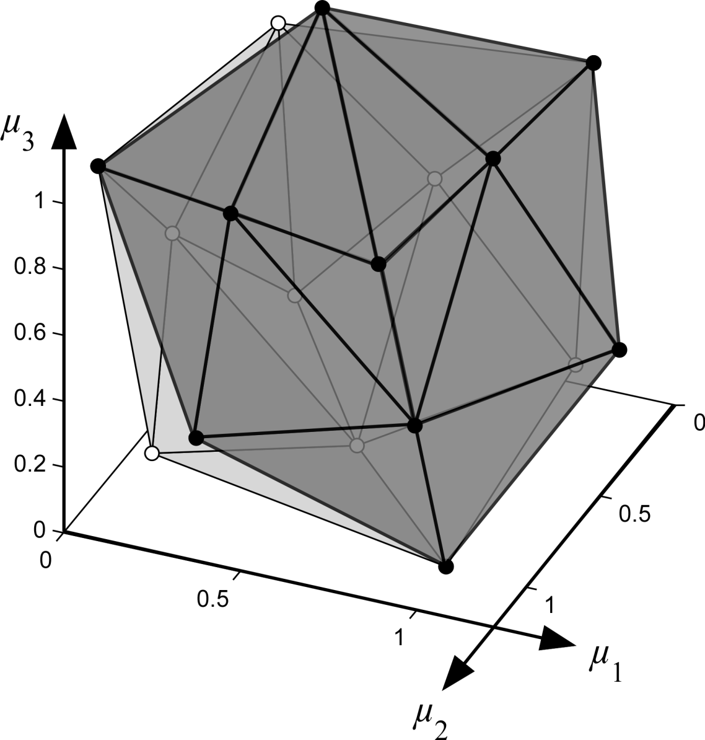
Additional Comments
Additional Comments:
nD Connectivity
Delaunay Triangulation
Special Characteristics
Dominated
Redundant
Separated

Slide 38
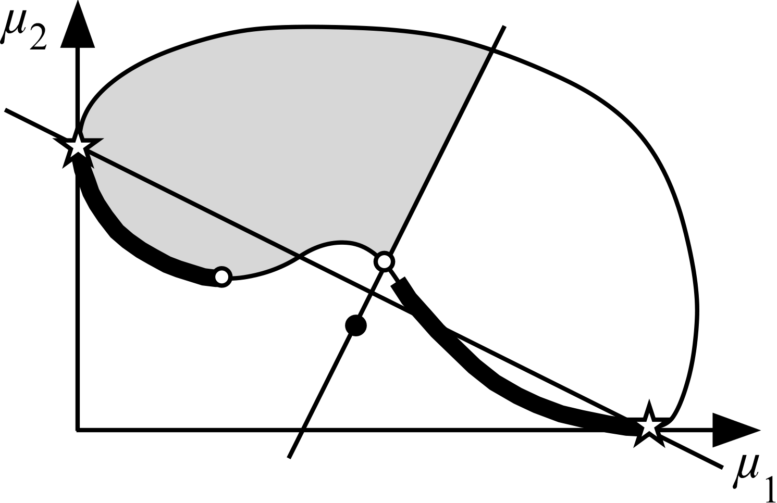
Additional Comments
New Dominated Point
Additional Considerations:
nD Connectivity
Delaunay Triangulation
Special Characteristics
Dominated
Redundant
Separated

Slide 39
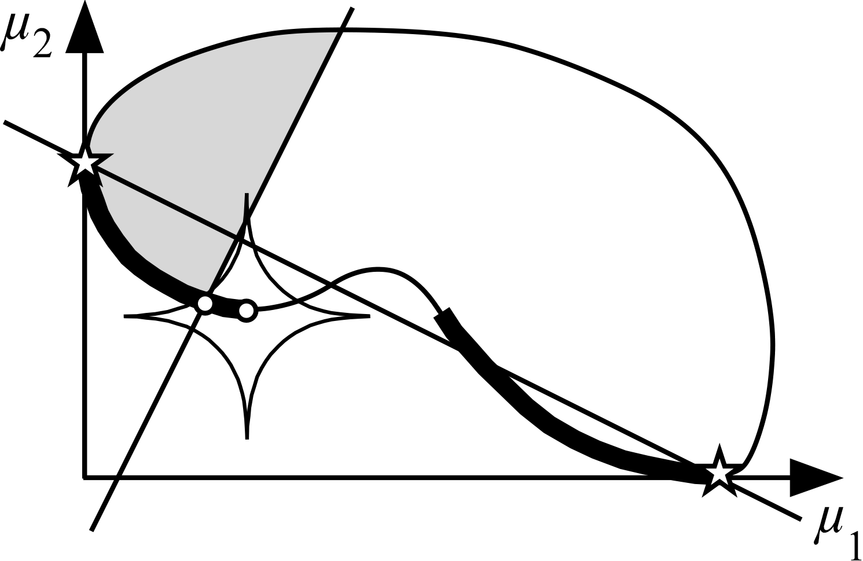
Additional Comments
Approximation Point outside PIT
Additional Considerations:
nD Connectivity
Delaunay Triangulation
Special Characteristics
Dominated
Redundant
Separated
New Pareto Point inside PIT

Slide 40
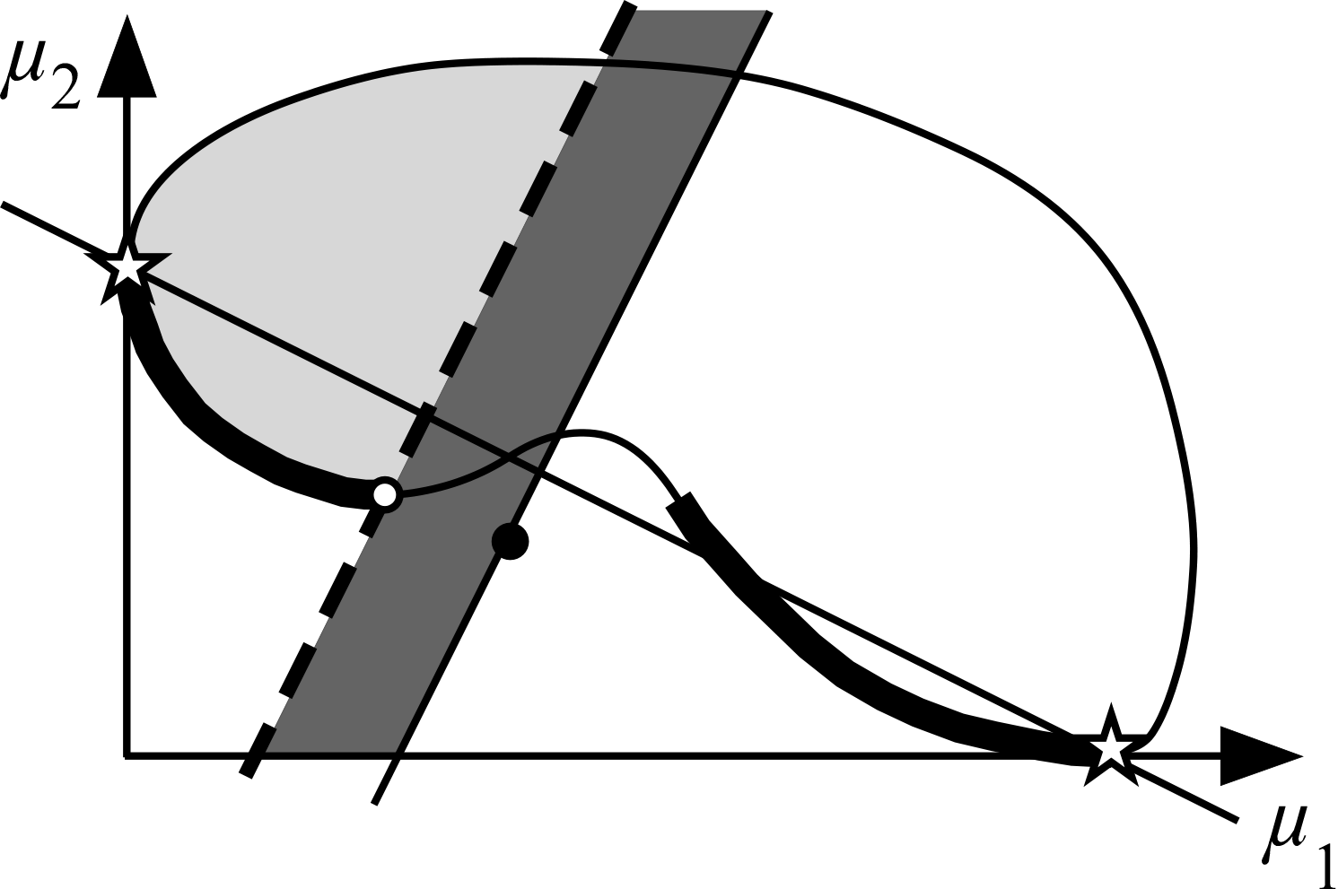
Additional Comments
New Restricted Region
Additional Considerations:
nD Connectivity
Delaunay Triangulation
Special Characteristics
Dominated
Redundant
Separated
Normal Constraint Used for SOO

Slide 41
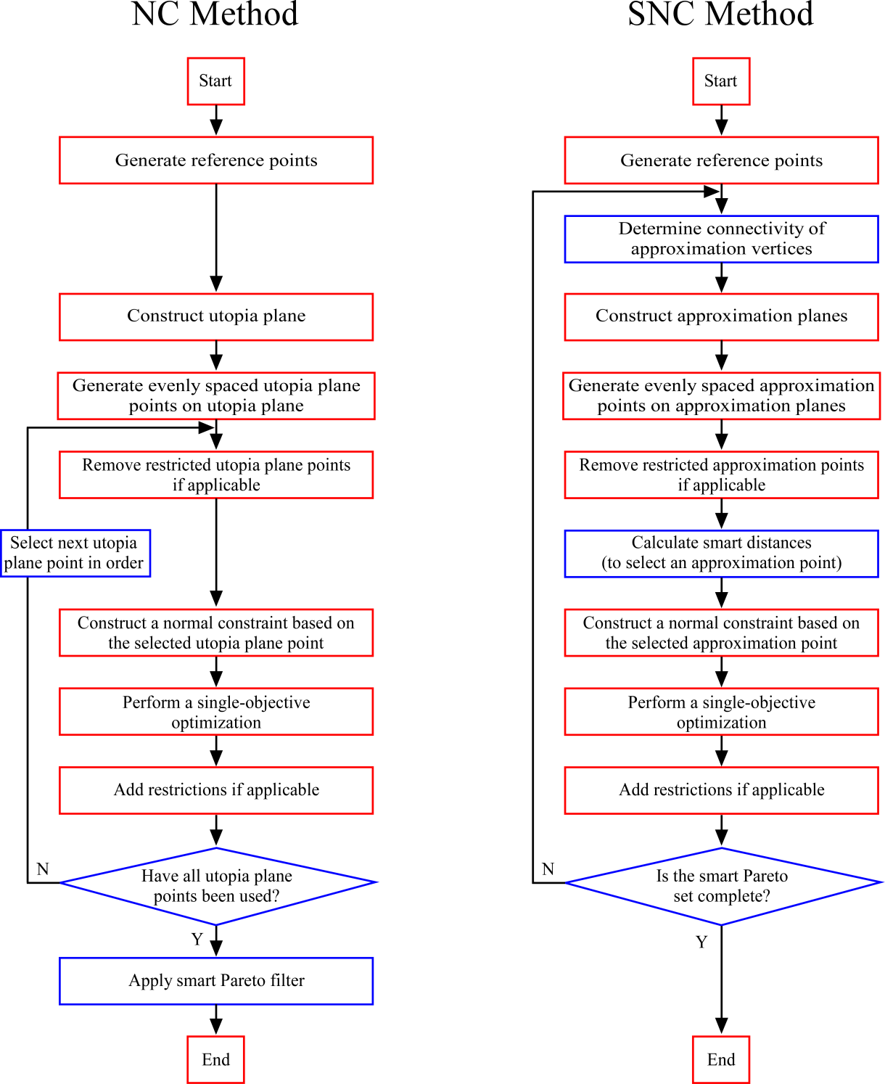

Slide 42
Example Problems
Problem | # Objectives | # Variables | # Constraints
TNK (Tanaka et al, 1995) | 2 | 2 | 2
Gear Box (Huang et al, 2006) | 3 | 7 | 11
WATER (Ray et al, 2001) | 5 | 3 | 7

Slide 43

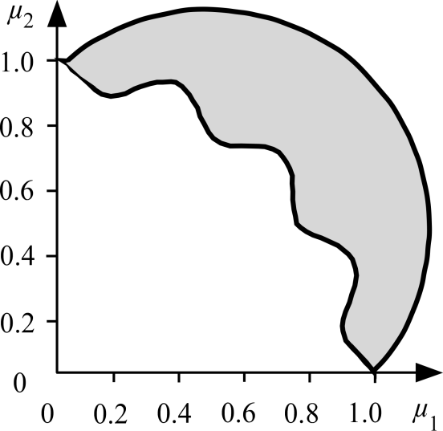
Example Methodology
Example Problem TNK (Tanaka et al, 1995)

Slide 44
Example Methodology
Example Problem TNK (Tanaka et al, 1995)
PIT Region

Slide 45
Example Results
Problem | Method | Total # Function Calls | % Decrease of Function Calls with SNC
TNK (Tanaka et al, 1995) | NC | 3,066 | 57%
 | SNC | 1,320
Gear Box (Huang et al, 2006) | NC | 17,600 | 65%
 | SNC | 6,205
WATER (Ray et al, 2001) | NC | 410,000 | 99%
 | SNC | 3,380

Slide 46
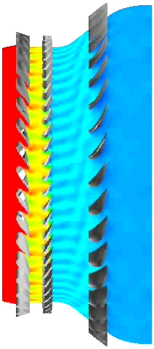
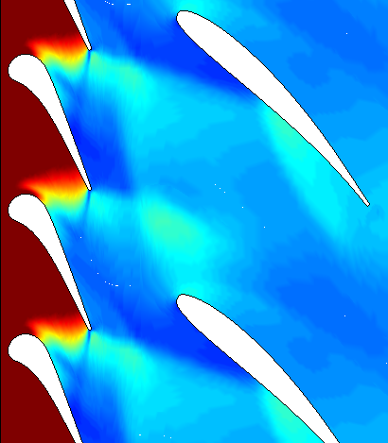
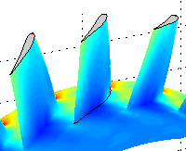
Engineering Application
Parameterized
Model
3D Unsteady RANS Analysis (CFD)
Optimized Geometry
NC Method + Smart Filter
400,000 function calls
6 hours per function call
80 CPUs
SNC Method
3,300 function calls
6 hours per function call
80 CPUs
3.5 Years
10 Days

Slide 47
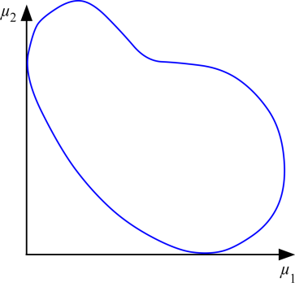


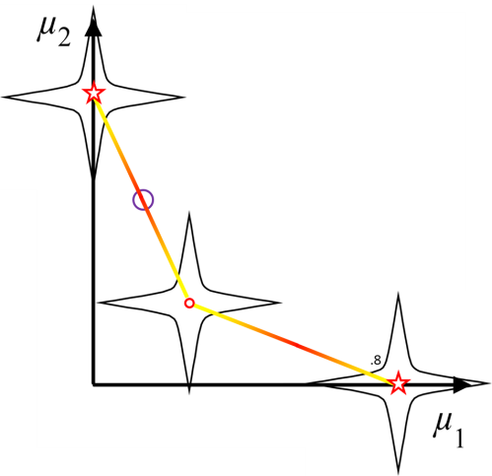
Future Work
1) Implementation in parallel
2) Gradient-based search for constraint location

Slide 48

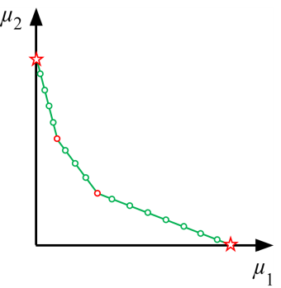
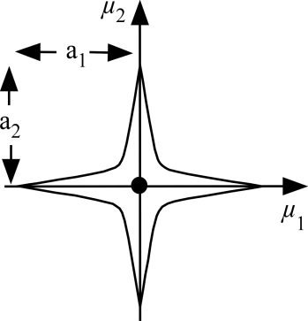
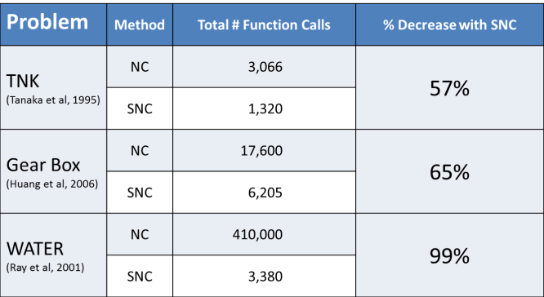
Conclusions
1) The SNC method is the first method capable of directly generating smart Pareto sets in n dimensions.
2) The SNC method is made possible through:
a) an iteratively updated approximation of the Pareto frontier
b) a novel scalar measurement for “smart distance”
p
3) The SNC method requires significantly fewer function calls than the predominant existing method for smart Pareto set generation in nearly all cases.

Slide 49
Bibliography
Huang HZ, Gu YK, Du X (2006) An interactive fuzzy multi-objective optimization method for engineering design. Engineering Applications of Artificial Intelligence 19:451-460
Mattson CA, Mullur AA, Messac A (2004) Smart Pareto filter: obtaining a minimal representation of multiobjective design space. Engineering Optimization 36:721-740
Messac A, Ismail-Yahaya A, Mattson CA (2003) The normalized normal constraint method for generating the Pareto frontier. Structural and Multidisciplinary Optimization 25:86-98
Ray T, Tai K, Seow C (2001) An evolutionary algorithm for multiobjective optimization. Engineering Optimization 33:399-424
Tanaka M, Watanabe H, Furukawa Y, Tanino T (1995) GA-based decision support system for multicriteria optimization. In: Proc. IEEE Int. Conf. Systems

